Slide 1
Certificate program in Data Science

Slide 2
Agenda
How to get started with Data Science as a career option
How to choose the right data science program
AI, ML, DL and Data Science Explained
Classical Programming vs Machine Learning
Application of Data Sciences
Why should I learn ML? Where is AI heading?
Steps to perform Machine Learning
Model development using Python
Introduction to GreyCampus Data Science certificate program
Q&A session

Slide 3
How to get started with Data Science as a career option
Visualization Expert - Tableau/ PowerBI
Business/ Data Analyst - lightweight exploratory analysis
Statistical Modeler - basic analytics
Machine Learning Engineer - model developer
Deep Learning Engineer - implementing Deep Learning
Data Engineer - big data, data pipeline, deployment

Slide 4
How to choose the right data science program
Current Role/ Background | Recommended Program
Business Analyst/ Operations/ Project Management/ Software Testing | Data Analysis, Tableau, Basic Analytics
Stats Background | Advanced Analytics, Statistical Modeling
Software Engineer | Machine Learning, Data Engineering
Machine Learning Engineer | Deep Learning

Slide 5
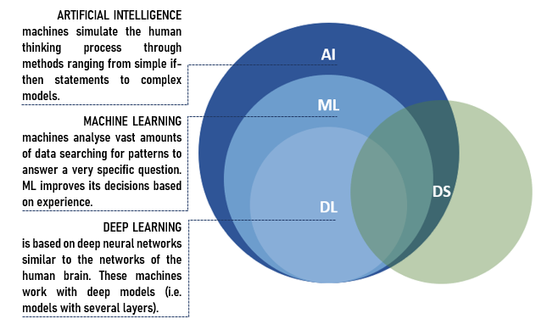
AI, ML, DL and Data Science Explained

Slide 6
Classical Programming vs Machine Learning
Classical Programming
Data
Computer
Output
Program
Machine Learning
Data
Computer
Program
Output

Slide 7
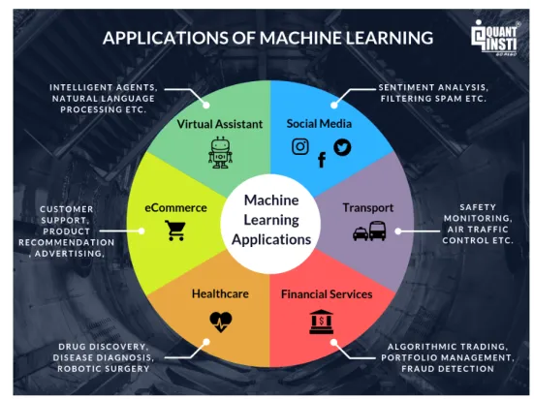
Applications of Data Sciences

Slide 8
Why should I learn ML? Where is AI heading?
The global machine learning market was valued at $1.58B in 2017 and is expected to reach $20.83B in 2024, growing at a CAGR of 44.06% between 2017 and 2024
According to SimplyHired.com, the average machine learning engineer salary is $142,000.An experienced machine learning engineer can earn up to $195, 752
Reference:-https://www.forbes.com/sites/louiscolumbus/2020/01/19/roundup-of-machine-learning-forecasts-and-market-estimates-2020/

Slide 9
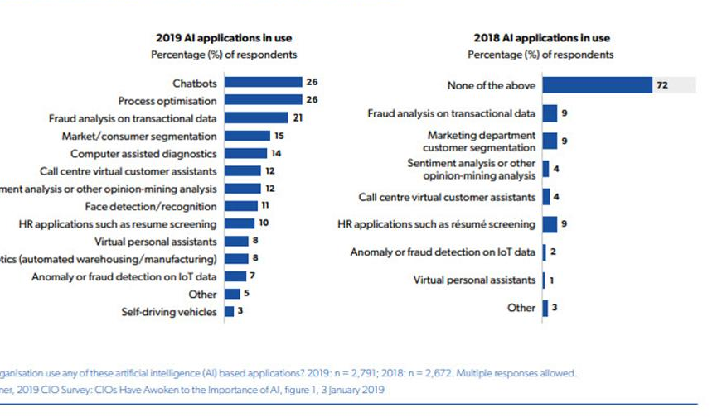
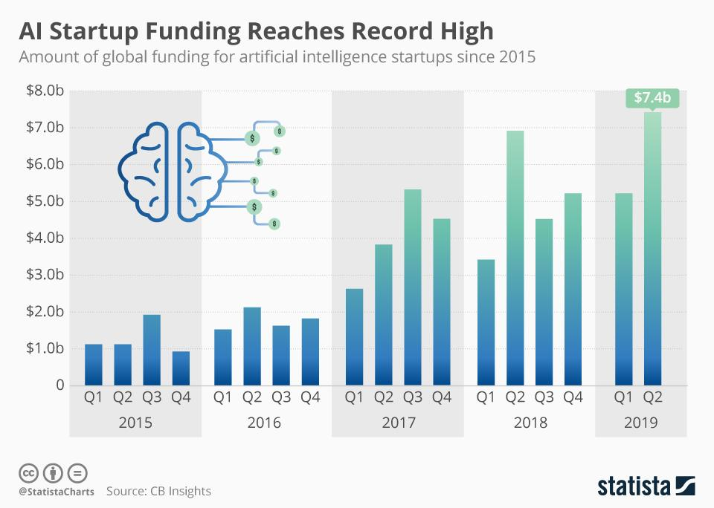
Why should I learn ML? Where is AI heading?

Slide 10
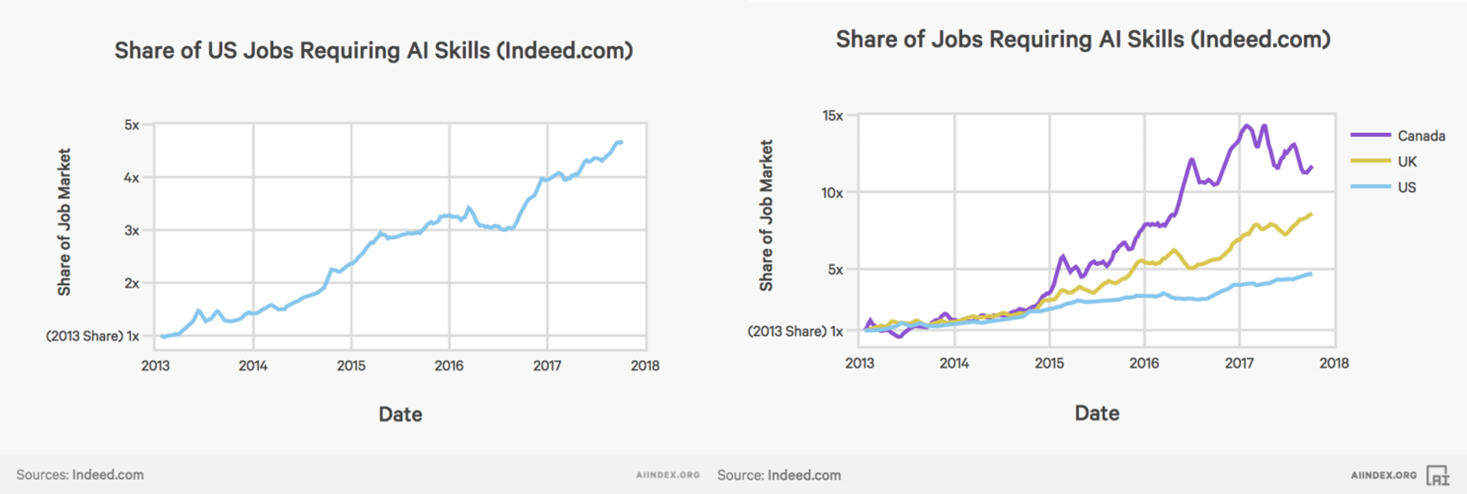
Why should I learn ML? Where is AI heading?

Slide 11
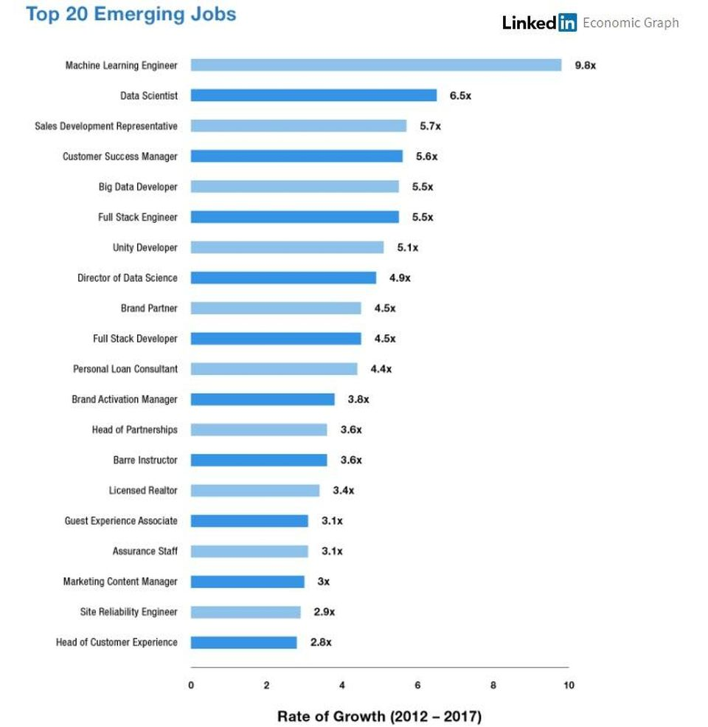
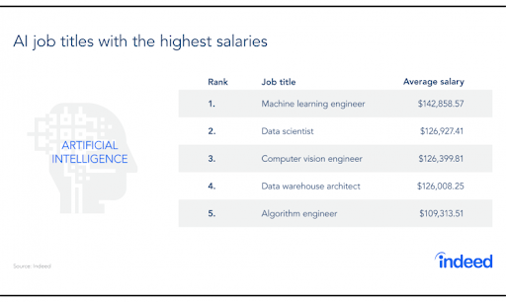
Why should I learn ML? Where is AI heading?

Slide 12
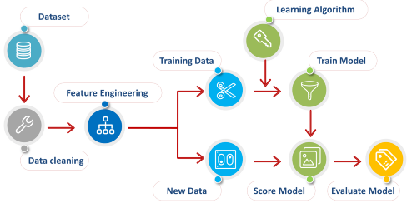
Steps to perform Machine Learning

Slide 13
Model development using Python
Anaconda - Distributor
Jupyter Notebook - IDE
Python - Language
Python libraries for Machine Learning
Pandas
Numpy
Matplotlib
Sklearn
Keras/ Pytorch

Slide 14
Introduction to GreyCampus Data Science certificate program
Data Science Basics
Data Science with Python
Machine Learning
Data Science with R
Big Data: Hadoop & Spark
Tableau Desktop
https://www.greycampus.com/certificate-program-in-data-science

